Slide 1

NoteWiz
AI Assisted Notepad
Revolutionizing Digital Note-Taking
PRESENTED BY:
ADVİSOR
Eray Ateş | 202011023
Halit Emir Turan | 202111068
Güneş Ölçer | 201911046
Zeynep Persil | 202011031
Asst. Prof. Dr. Faris Serdar TAŞEL

Slide 2

what
NoteWiz is an AI-powered note-taking application designed to simplify and enhance productivity for professionals, students, and teams by integrating features like automated summarization, real-time collaboration, and secure data management.
why
It was created to address inefficiencies in traditional tools, such as time-consuming manual organization and lack of real-time collaboration, providing users with smarter solutions for streamlined workflows, enhanced collaboration, and robust data security.
how
By leveraging cutting-edge AI technologies, including natural language processing and machine learning, NoteWiz provides intelligent features such as automatic summarization, personalized recommendations, and interactive question-answering. Its robust infrastructure ensures seamless cross-platform synchronization and a user-friendly interface tailored to diverse user needs.
Project
Overview

Slide 3
Problems & Solutions
 | Traditional note-taking tools like Microsoft OneNote and Evernote require manual organization and summarization, leading to significant time loss and decreased productivity. Users often spend more time organizing notes than focusing on the actual content. | NoteWiz eliminates inefficiencies by integrating note-taking, task management, and real-time collaboration into a single platform, streamlining workflows and saving time.
 | Few platforms utilize AI to provide personalized suggestions or automate repetitive tasks, leaving users without advanced features like intelligent summarization and priority-based insights. | Integrates AI to deliver personalized suggestions, tagging, and categorization. Helps reduce manual effort through intelligent automation.
 | Many popular apps like Apple Notes and Simplenote fail to provide seamless cross-device synchronization or robust offline functionality. This results in inconsistent user experiences and productivity losses, especially in low-connectivity environments. | NoteWiz ensures real-time synchronization across all devices and offers a powerful offline mode for creating and editing notes without internet access, making it reliable even in challenging conditions.
problem
definition
solution
01: Inefficiency
02: No AI
03: Limited Accessability

Slide 4
 | NoteWiz uses AI to provide smart, automated, and personalized note-taking. How : We will implement this feature with AI APIs like OpenAI.
 | Access notes seamlessly across multiple devices anytime, anywhere. How: Cross-device note access is achieved using Firebase for authentication, real-time database syncing, and offline support.
 | Easily share notes with others and collaborate in real time. How: Using WebSocket we can reflect changes to notes in real time to each user, or we can store the notes in the same way with Firebase and allow users to interact instantly.
Key Features
01
AI-Powered
Cross-Device Access
02
Sharing and Collaboration
03

Slide 5
Architecture
 | React and Material UI. | Provides an interactive and responsive user interface for creating, editing, and managing notes and tasks. | User authentication (login, signup). Dashboard for an overview of tasks and notes. Rich text editor with AI integrations.
 | Firebase Cloud Functions, OpenAI API. | Processes user input, applies business logic, and integrates AI features. | AI-powered summarization and Q&A. Real-time collaboration management. Tagging and categorization algorithms.
 | Firebase Real-Time Database and Cloud Storage. | Stores user data securely, ensuring real-time updates across devices. | User profiles and preferences. Notes, tasks, and collaboration data. Encrypted backups and data recovery.
layer
technology
functionality
features
01
Presentation
Layer
Application Logic Layer
02
03
Data Layer

Slide 6
Automated Summarization
Intelligent Tagging and Categorization
Converts lengthy text into concise summaries, highlighting key points.
Supports both extractive (pulling key phrases) and abstractive (paraphrasing content) summarization techniques.
Automatically assigns relevant tags to notes based on their content.
Groups related notes for easier navigation and retrieval.
A React app sends note content to a backend API, which uses OpenAI's GPT API to analyze and generate relevant tags or group related notes, then displays the results in the app.
How It Works
How It Works
Prepare Input Data
Allow users to input or upload lengthy text that needs summarization.
Send Request to GPT API
Use the OpenAI GPT API to generate abstractive summaries
Display the Summary
Show the generated summary in a user-friendly interface with options to save, edit, or copy it.
Contextual Q&A
Allows users to ask questions about their notes or uploaded documents.
Provides precise, context-aware answers using NLP models.
AI-Powered Features

Slide 7
Optical Character Recognition
AI-Powered Features
OCR (Optical Character Recognition) in NoteWiz allows users to extract text from images, scanned documents, or handwritten notes seamlessly. This feature digitizes physical content, enabling AI-powered functionalities like summarization, tagging, and Q&A for a more integrated and efficient note-taking experience.
How It Works
Predictive Task Management
The Predictive Task Management feature in NoteWiz leverages GPT API to analyze user activity and provide intelligent task recommendations.
Tesseract.js
JavaScript-based OCR library.
Runs locally, making it a good choice for offline OCR.
How It Works
AI-Generated Cover Photos for Notes:
1- Data Analysis:
-User notes, completed tasks, and recurring patterns are analyzed.
2-GPT API Usage:
-This data is sent as a prompt to the GPT API, which generates personalized task suggestions based on past activities and patterns.
3-User Interface:
-Recommendations are displayed in a simple list format.
-Users can accept, edit, or dismiss suggestions directly from the app.
Automatically generates visually appealing cover images for each note based on its content.
Enhances the visual organization and categorization of notes.
Uses image generation algorithms to create context-relevant graphics.
AI Note Covers in NoteWiz are implemented by using APIs to access AI models like OpenAI's DALL·E, generating context-relevant images based on note metadata.
How It Works

Slide 8

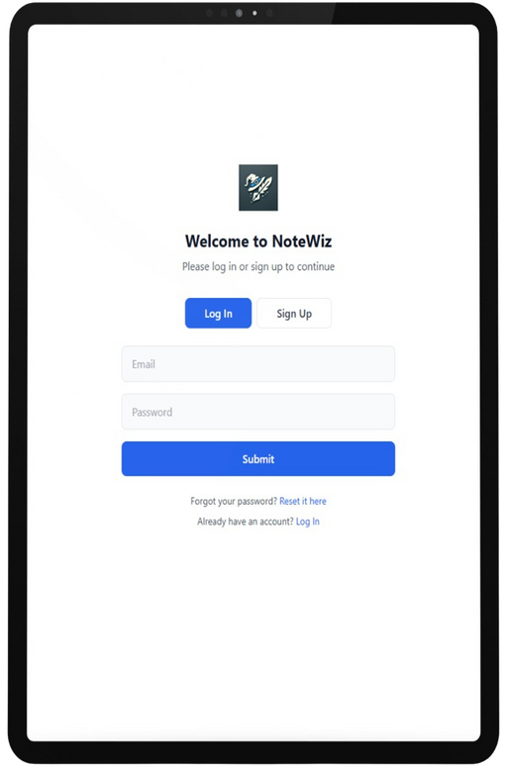
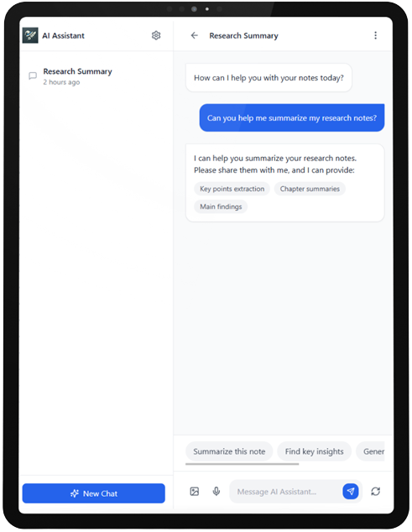
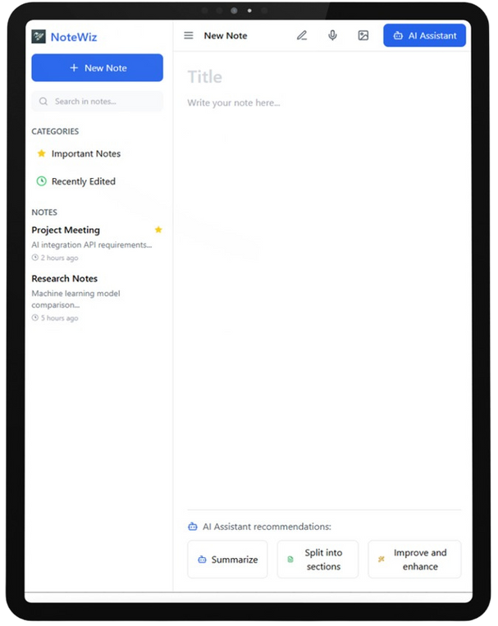

SIMPLICITY
CONSISTENCY
User interface design for an intuitive user experience.
User onboarding materials (tutorials, guides).
The design offers a clean and simple layout that prioritizes core functionality.
It ensures an easy user experience with intuitive navigation and minimal clicks required to access any feature.
DYNAMIC UI
Light and dark and another tema options to cater to user preferences and reduce eye strain.
Selectable fonts and textures!
UI Design

Slide 9
Evolution of NoteWiz
01
02
03
AI Integration
Real-Time Note Sharing
AI Note Covers
AI Integration in NoteWiz enhances productivity by enabling features like automated summarization, intelligent tagging, contextual Q&A, and personalized recommendations.
We will implement this feature with AI APIs like OpenAI.
Easily share notes with others and collaborate in real time.
Using WebSocket we can reflect changes to notes in real time to each user, or we can store the notes in the same way with Firebase and allow users to interact instantly.
AI Note Covers in NoteWiz automatically generate visually appealing and context-relevant images for notes.
To generate images by AI, you can use an API like DALL E from OpenAI. These types of APIs usually offer the ability to generate images from text.

Slide 10
Evolution of NoteWiz
04
05
OCR
Calendar
OCR in NoteWiz converts text from images and scanned documents into editable digital notes, enabling seamless integration with AI features like summarization and tagging.
The calendar feature in NoteWiz helps users manage tasks and deadlines by integrating notes with a visual timeline, enabling efficient scheduling and organization.
(We planned to use @fullcalendar/react
API )

Slide 11
future plans!
06
07
08
Speech-To-Text Notes!
Translation!
NoteHub!
Speech-to-Text Notes will enable users to convert spoken words into digital text, offering hands-free and efficient note-taking.
The multilingual translation feature in NoteWiz will allow users to translate their notes into different languages instantly, enhancing accessibility and global collaboration.
NoteHub is a planned feature for NoteWiz, designed as a shared space where users can contribute and collaborate on notes in real time. It will serve as a central hub for teamwork, enabling seamless sharing, editing, and brainstorming.
Microsoft Azure Speech Service
Real-time transcription with noise cancellation
Ideal for enterprise-level applications..
Microsoft Translator Text API (Azure)
Offers translation with context awareness and additional features like transliteration.

Slide 12
Summary
Looking Ahead
To summarize, NoteWiz uses advanced AI and a user-friendly design to transform note-taking and productivity.
It simplifies workflows and increases efficiency with features like automatic summarization, cross-device access, and real-time collaboration.
Notewiz will continue to expand the functionality of the platform with planned features such as Speech-to-Text Notes, NoteHub, and advanced AI integrations in its ongoing work.
Value Delivered
Closing Statement
The value delivered by NoteWiz is providing a unified platform that allows users to manage notes, tasks, and collaborations securely and intuitively.
In conclusion, NoteWiz is not just a note-taking tool; it is a productivity companion designed to adapt to the ever-changing needs of its users.
Conclusion

Slide 13

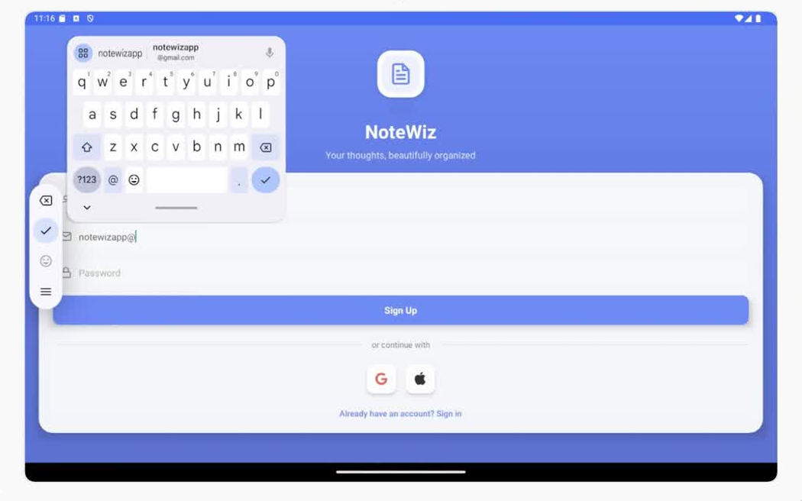
Prototype

Slide 14
Thank you for your attention! We’re happy to address any questions you may have about NoteWiz and its features.
Feel free to share your feedback or suggestions for future improvements.
Q&A

